Slide 1
Module 2, Part 1: Statistical Learning TMA4268 Statistical Learning V2023
Daesoo Lee,
Department of Mathematical Sciences, NTNU
16/01/2023

Slide 2
Acknowledgements

Slide 3
Acknowledgements
A lot of this material stems from Mette Langaas and her TAs (especiall Julia Debik). I would like to thank Mette for the permission to use her material!

Slide 4
Introduction

Slide 5
Introduction
Learning material for this module
James et al (2013): An Introduction to Statistical Learning. Chapter 2 (except 2.2.3).
Additional material (in this module page) on random variables, covariance matrix and the multivariate normal distribution (known for students who have taken TMA4267 Linear statistical models).

Slide 6
Introduction
What will you learn?
Statistical learning and examples
Introduce relevant notation and terminology
Prediction accuracy vs. model interpretability
Bias-variance trade-off

Slide 7
What is statistical learning?

Slide 8
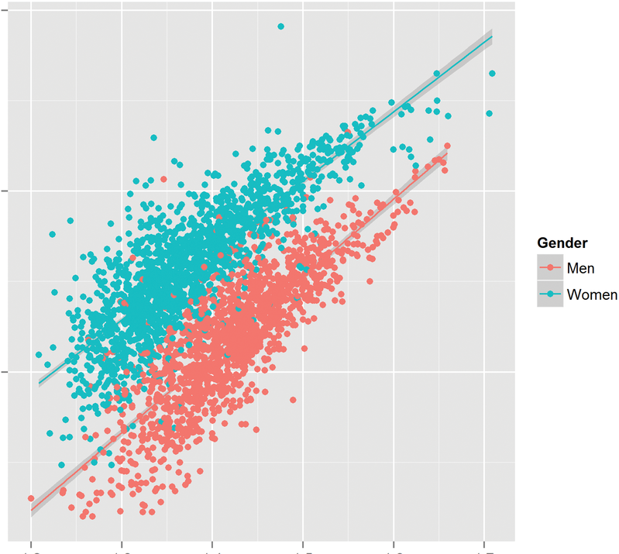
What is statistical learning?
Statistical learning is the process of learning from data. We would like to
draw conclusions about the relations between the variables (inference) or
find a predictive function for new observations (prediction).
Want to find structures in the data that help us to learn something about the real world.
Plays a key role in many areas of science, finance and industry.
A fundamental ingredient in the training of a modern data scientist.
Body Fat
BMI
Fuster-Parra, Pilar, et al. "A comparison between multiple regression models and CUN-BAE equation to predict body fat in adults." PloS one 10.3 (2015): e0122291.

Slide 9
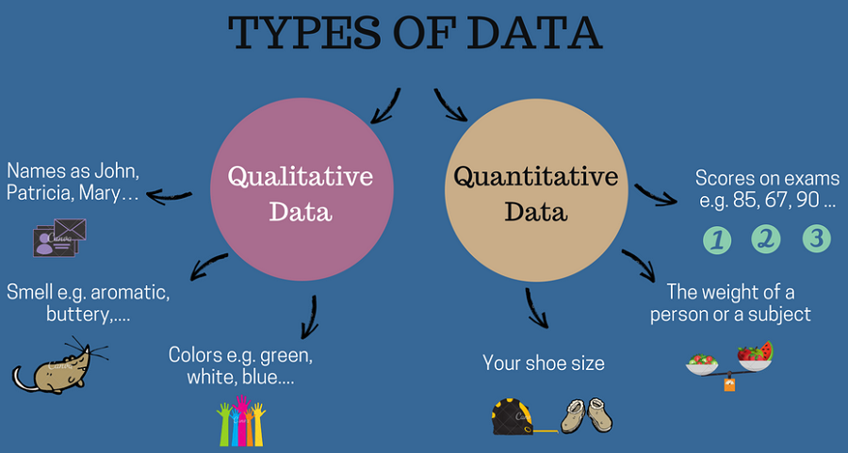

What is statistical learning?
Two variable types

Slide 10
What is statistical learning?
Two variable types
Quantitative variables are variables from a continuous set, they have a numerical value.
Examples: a person’s weight, a company’s income, the age of a building, the temperature outside, the level of precipitation etc.
Qualitative variables are variables from a discrete set with 𝐾 different classes/labels/categories.
Examples: type of fruit {apples, oranges, bananas, …}, sex {male, female, other }, education level {none, low, medium, high}.
Qualitative variables which have only two classes are called binary variables and are usually coded by 0 (no) and 1 (yes).

Slide 11
Examples of learning problems

Slide 12
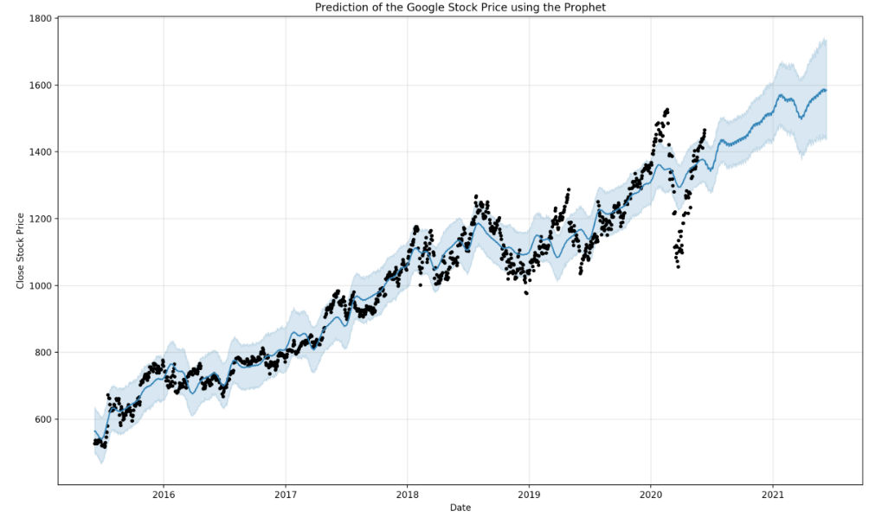
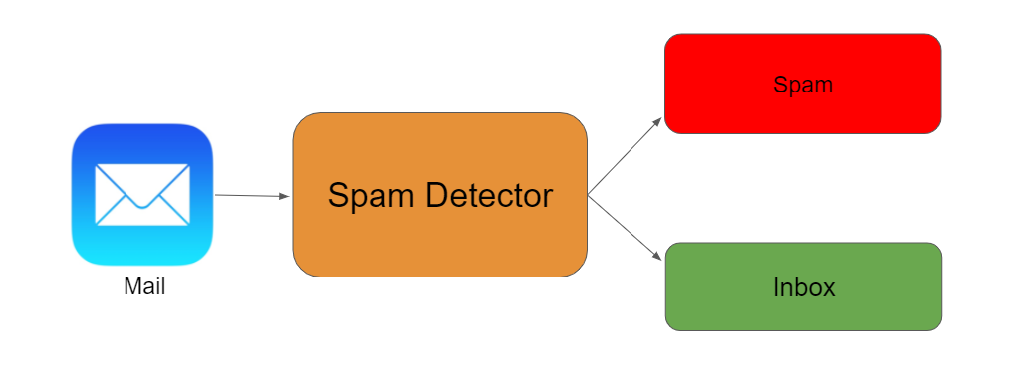
Examples of learning problems
Examples of learning problems
Spam Detector
(binary outcome)
Stock Forecasting
(continuous outcome)
Identification of risk factors for Prostate cancer (yes/no).
Estimating the risk of heart disease, given knowledge about condition, behaviour, age, or demographic, diet and clinical measurements.

Slide 13
Examples of learning problems
Example 1: Handwritten digit recognition
Classification problem with categorical response variable {0, 1, 2, …, 9}.
Image taken from https://web.stanford.edu/~hastie/ElemStatLearnII/

Slide 14
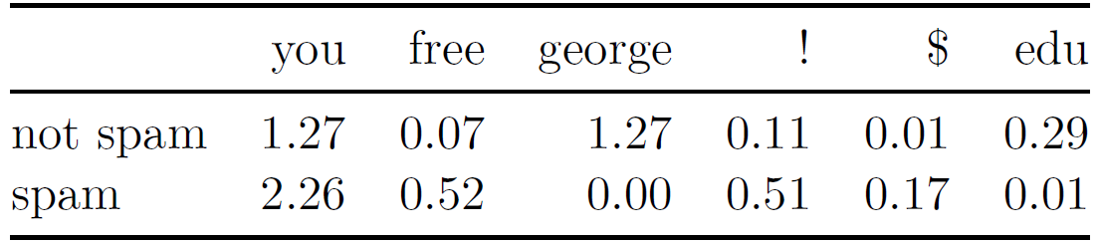
Examples of learning problems
Example 2: Email classification (spam detection)
The table below shows the average percentage of words or characters in an email message, based on 4601 emails of which 1813 were classified as a spam.
The classification model can be based on the frequencies of words in emails.
Fig. Average percentage of words or characters in 4601 emails.

Slide 15
The Supervised Learning Problem

Slide 16
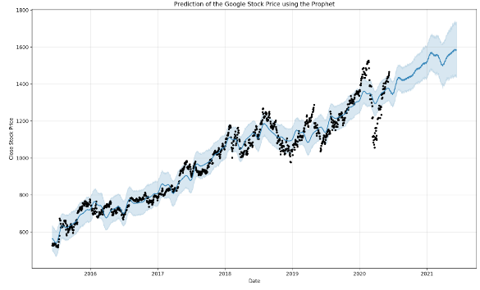
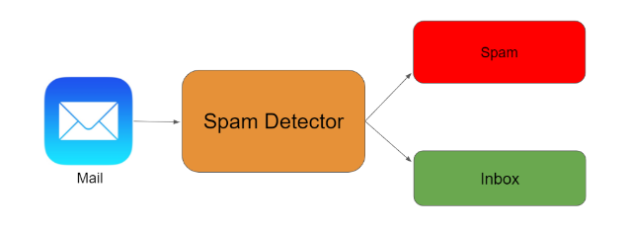
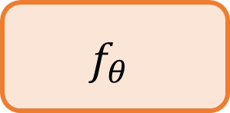
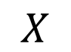
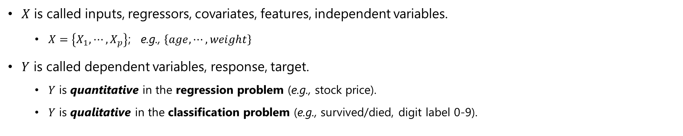
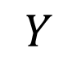
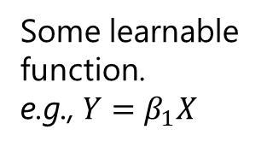
The Supervised Learning Problem
Quantitative; Regression problem (e.g., 1820)
$$f_{θ}$$
$$X$$
$$Y$$
Some learnable function. e.g., $Y=β_{1}X$
Qualitative; Classification problem
$X$ is called inputs, regressors, covariates, features, independent variables.
$X=\left\{X_{1},⋯,X_{p}\right\}$; e.g., $\left\{age,⋯,weight\right\}$
$Y$ is called dependent variables, response, target.
$Y$ is quantitative in the regression problem (e.g., stock price).
$Y$ is qualitative in the classification problem (e.g., survived/died, digit label 0-9).

Slide 17
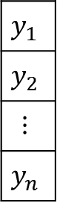
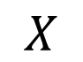
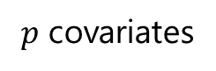
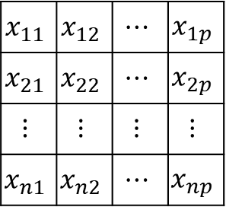
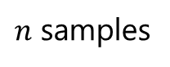
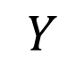

The Supervised Learning Problem
Supervised learning and its objectives
Training Scheme
After training, we’d like to:
Accurately predict unseen test cases.
Understand which covariate(s) affects the output.
Assess the quality of our predictions and inference.
$$f_{θ}$$
$$X$$
$$Y$$
$p$ covariates
$$x_{11}$$ | $$x_{12}$$ | $$⋯$$ | $$x_{1p}$$
$$x_{21}$$ | $$x_{22}$$ | $$⋯$$ | $$x_{2p}$$
$$⋮$$ | $$⋮$$ | $$⋮$$ | $$⋮$$
$$x_{n1}$$ | $$x_{n2}$$ | $$⋯$$ | $$x_{np}$$
$$y_{1}$$
$$y_{2}$$
$$⋮$$
$$y_{n}$$
$n$ samples

Slide 18
Notation and key statistical concepts

Slide 19
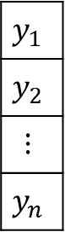
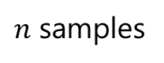
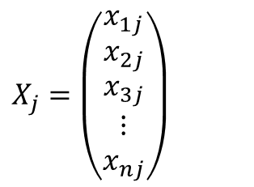
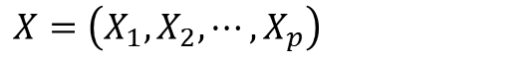
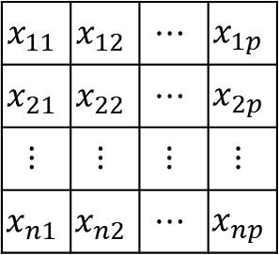
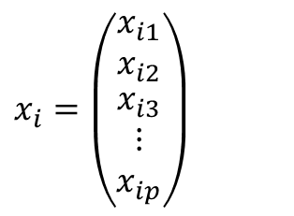

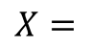
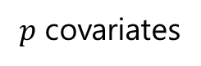

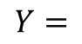
Notation and key statistical concepts
$p$ covariates
$$x_{i}=\left(\begin{matrix}x_{i1} \\ x_{i2} \\ \begin{matrix}x_{i3} \\ ⋮ \\ x_{ip}\end{matrix}\end{matrix}\right)$$
$$x_{11}$$ | $$x_{12}$$ | $$⋯$$ | $$x_{1p}$$
$$x_{21}$$ | $$x_{22}$$ | $$⋯$$ | $$x_{2p}$$
$$⋮$$ | $$⋮$$ | $$⋮$$ | $$⋮$$
$$x_{n1}$$ | $$x_{n2}$$ | $$⋯$$ | $$x_{np}$$
$$X=$$
$n$ samples
$$X=\left(X_{1},X_{2},⋯,X_{p}\right)$$
$$X_{j}=\left(\begin{matrix}x_{1j} \\ x_{2j} \\ \begin{matrix}x_{3j} \\ ⋮ \\ x_{nj}\end{matrix}\end{matrix}\right)$$
$$y_{1}$$
$$y_{2}$$
$$⋮$$
$$y_{n}$$
$$Y=$$

Slide 20
The Unsupervised Learning Problem

Slide 21
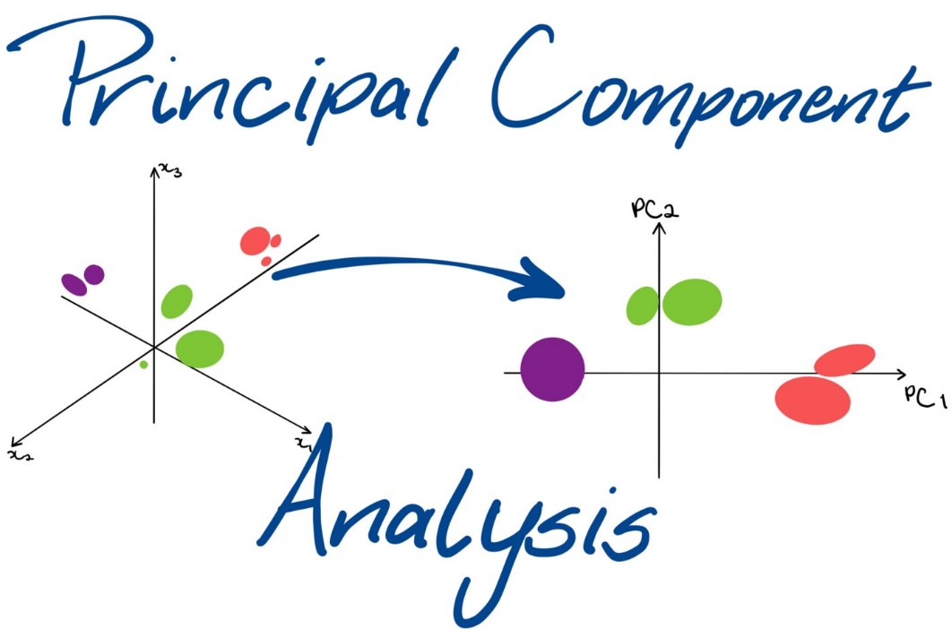
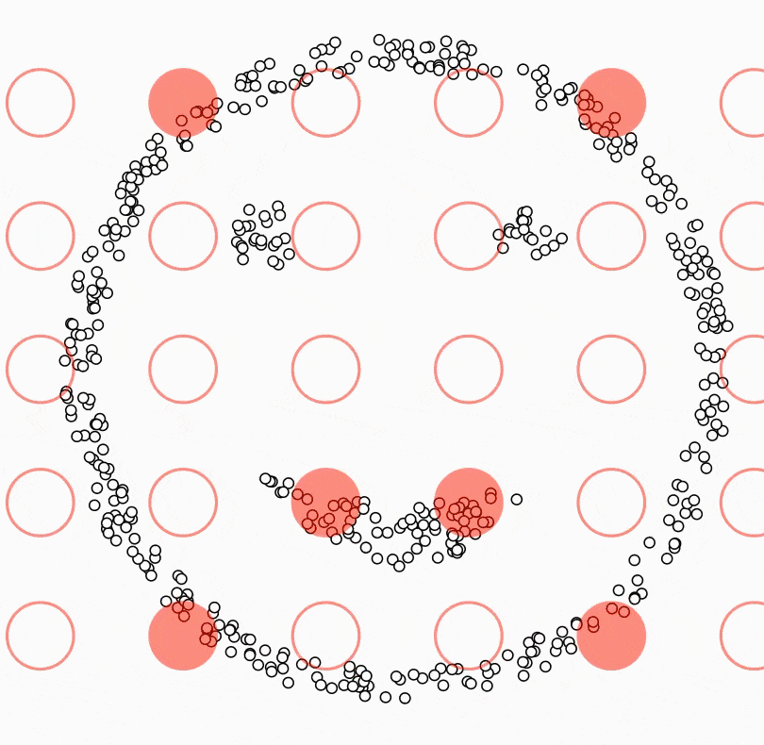
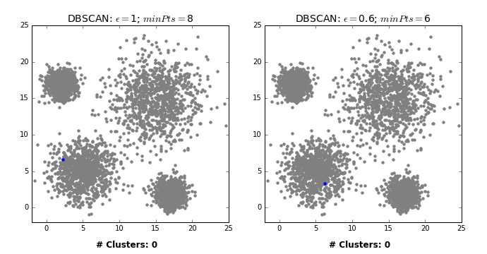
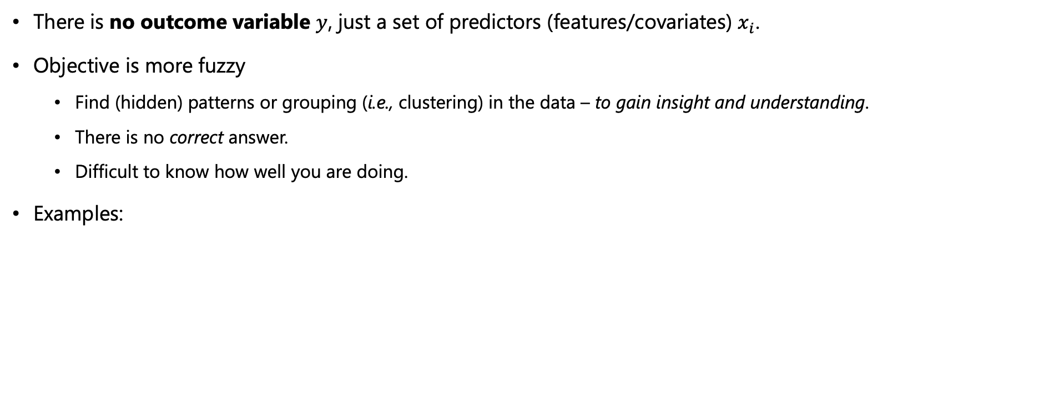
The Unsupervised Learning Problem
There is no outcome variable $y$, just a set of predictors (features/covariates) $x_{i}$.
Objective is more fuzzy
Find (hidden) patterns or grouping (i.e., clustering) in the data – to gain insight and understanding.
There is no correct answer.
Difficult to know how well you are doing.
Examples:
DBSCAN

Slide 22
Overall philosophy

Slide 23
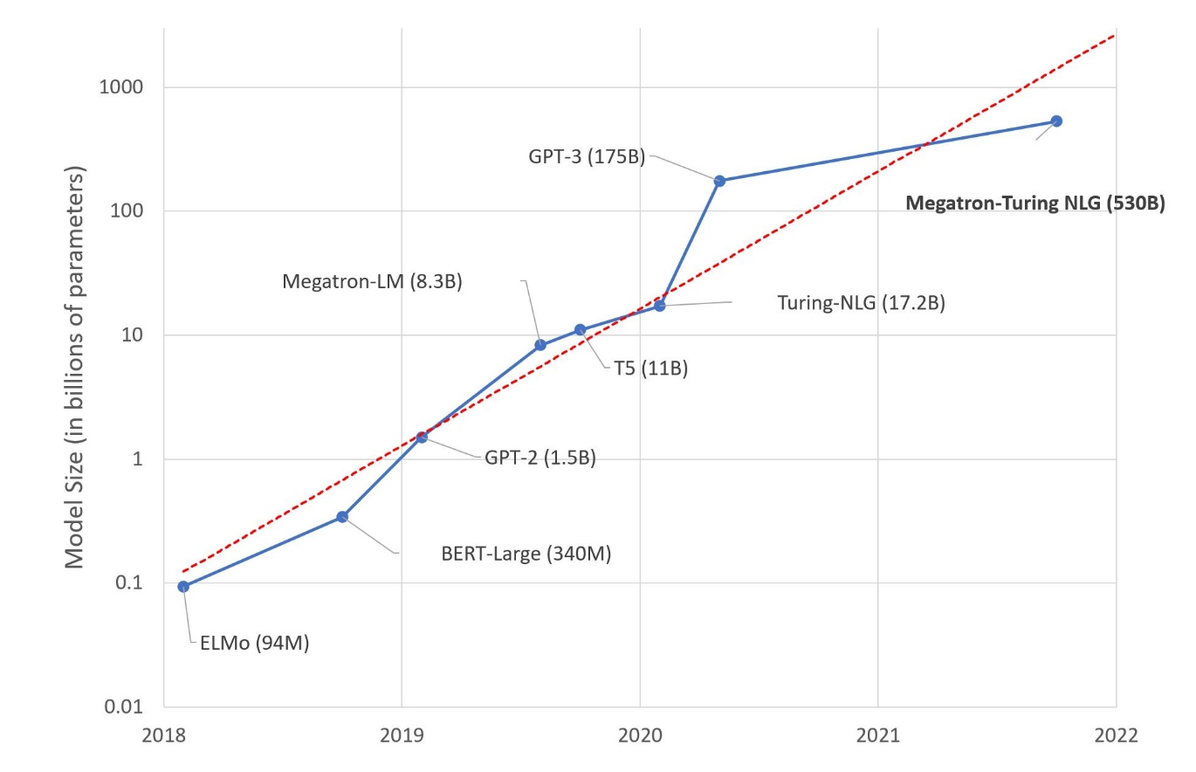
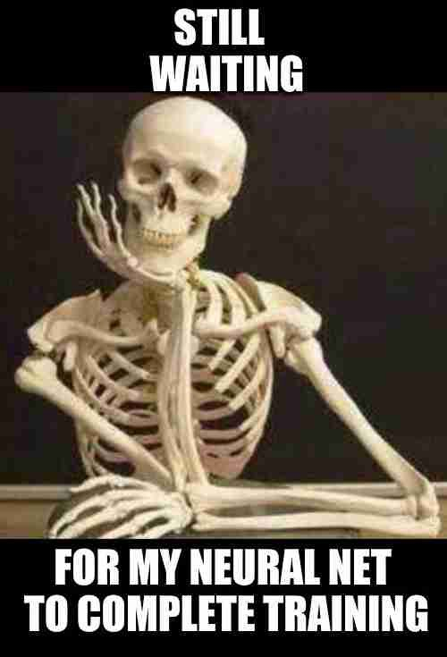

Overall philosophy
Important to understand the simpler methods first, in order to grasp the more sophisticated ones.
Simpler methods often perform as well as fancier ones!
It is important to accurately assess the performance of a method, to know how well or how badly it is working.
Important to understand the simpler methods first, in order to grasp the more sophisticated ones.
Simpler methods often perform as well as fancier ones!
It is important to accurately assess the performance of a method, to know how well or how badly it is working.

Slide 24
Statistical Learning vs. Machine Learning

Slide 25
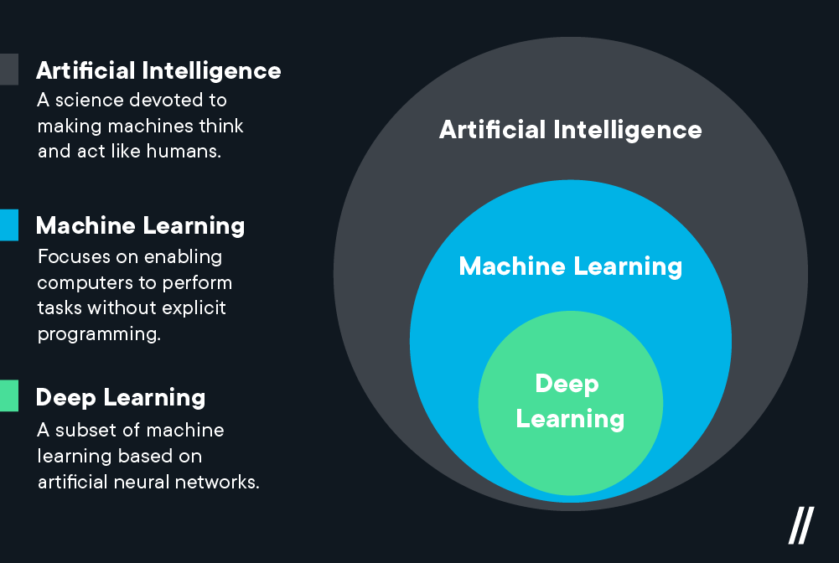
Statistical Learning vs. Machine Learning
Machine learning arose as a subfield of Artificial Intelligence.
Statistical learning arose as a subfield of Statistics.
There is much overlap -- both fields focus on supervised and unsupervised problems:
Machine learning has a greater emphasis on large scale applications and prediction accuracy.
NB! Explainable AI is a current hot topic though!
Statistical learning emphasizes models and their interpretability, and precision and uncertainty.
The distinction has become more and more blurred, and there is a great deal of “cross-fertilization”.
Machine learning has the upper hand in Marketing!

Slide 26


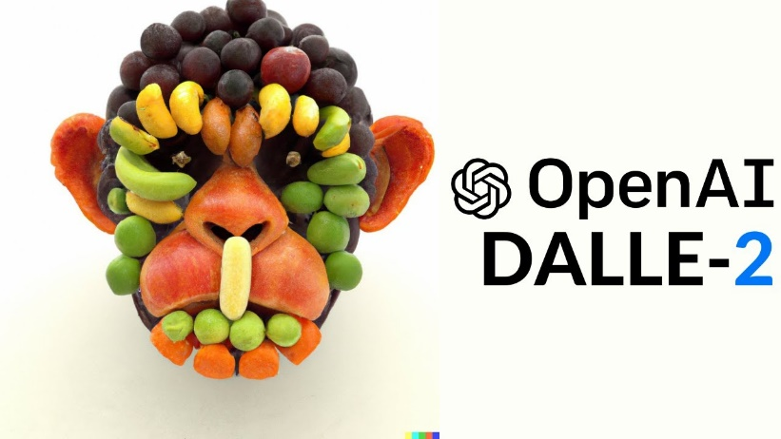
Statistical Learning vs. Machine Learning
There is a controversy and some skepticism against ``too fancy'' ML methods.
Criticism:
ML often re-invents existing methods and names them differently, but often without awareness of existing methods in statistics.
Despite the record-breaking performances by Deep Learning, the models are often not fully understood.
Yet, the progress has been remarkable:

Slide 27
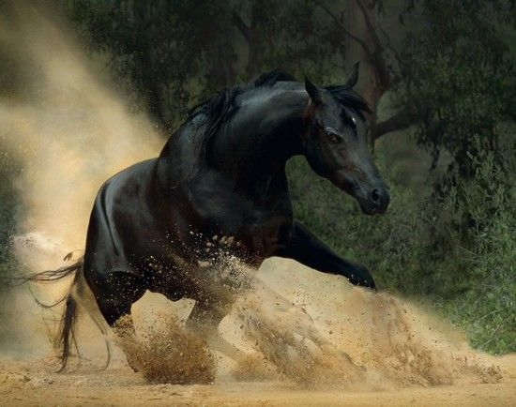
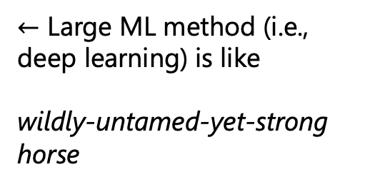
Statistical Learning vs. Machine Learning
Deep Learning is like..
$←$ Large ML method (i.e., deep learning) is like
wildly-untamed-yet-strong horse

Slide 28
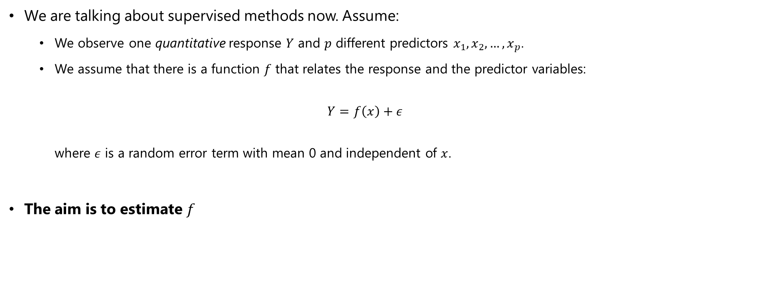
Statistical Learning vs. Machine Learning
What is the aim in statistical learning?
We are talking about supervised methods now. Assume:
We observe one quantitative response $Y$ and $p$ different predictors $x_{1},x_{2},…, x_{p}$.
We assume that there is a function $f$ that relates the response and the predictor variables: $Y=f\left(x\right)+ε$ where $ε$ is a random error term with mean 0 and independent of $x$.
The aim is to estimate $f$

Slide 29
Examples of Statistical Learning

Slide 30
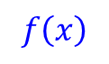
Examples of Statistical Learning
Example1: Sales of a product, given advertising budgets in different media
$$f\left(x\right)$$

Slide 31
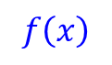
Examples of Statistical Learning
Example 2: Income for given levels of education
$$f\left(x\right)$$

Slide 32
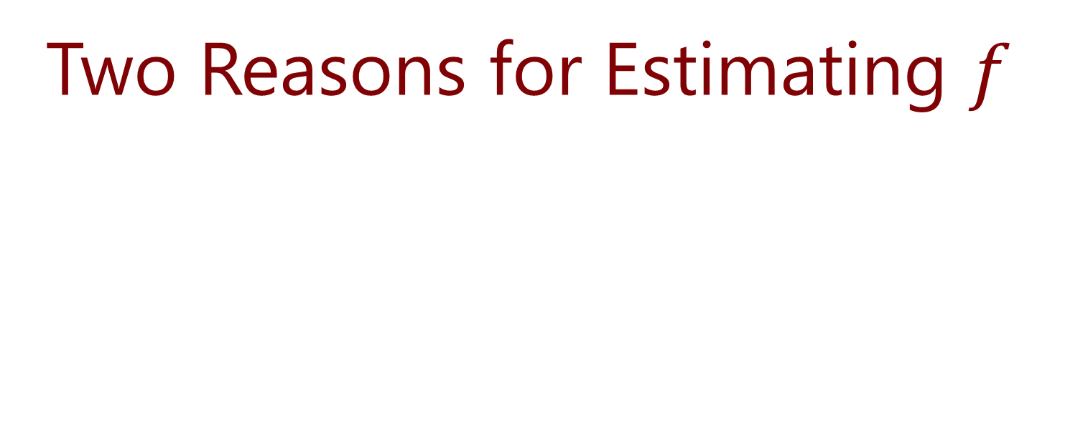
Two Reasons for Estimating $f$

Slide 33
Two Reasons for Estimating $f$
Reason1: Prediction
Reason2: Inference

Slide 34
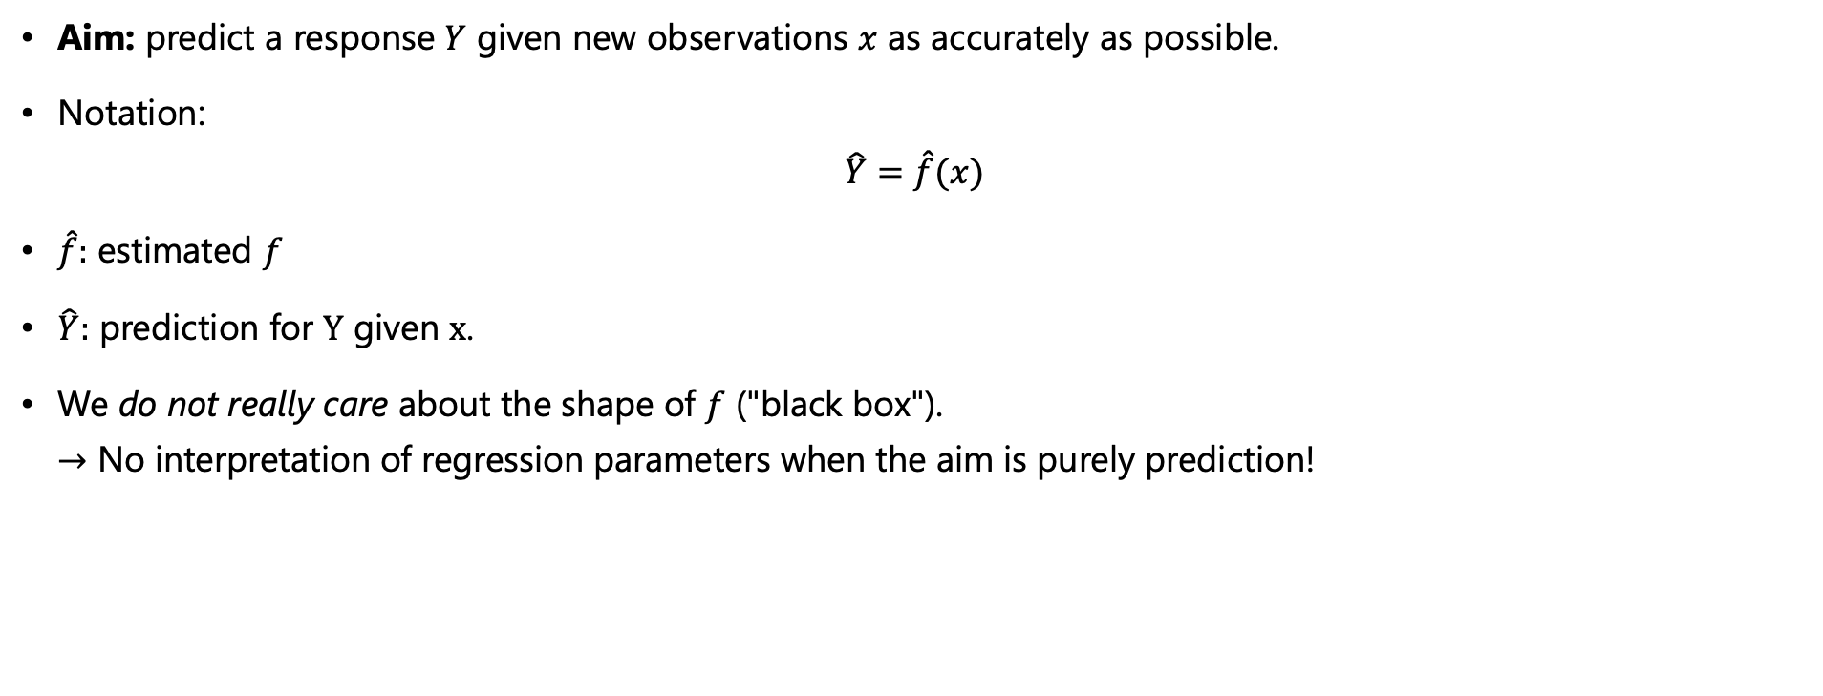
Two Reasons for Estimating $f$
Reason 1: Prediction
Aim: predict a response $Y$ given new observations $x$ as accurately as possible.
Notation: $\hat{Y}=\hat{f}(x)$
$\hat{f}:$ estimated $f$
$\hat{Y}:$ prediction for $Y$ given $x$.
We do not really care about the shape of $f$ ("black box"). $→$ No interpretation of regression parameters when the aim is purely prediction!

Slide 35
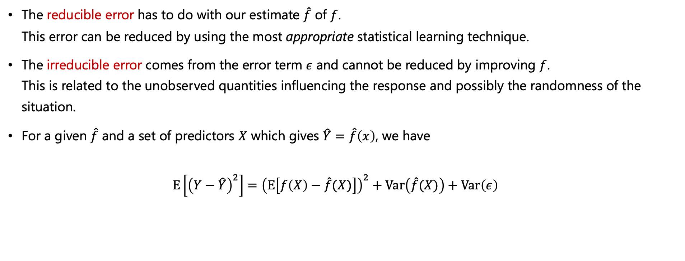
Two Reasons for Estimating $f$
Two quantities which influence accuracy of $\hat{Y}$ (= prediction of $Y$)
The reducible error has to do with our estimate $\hat{f}$ of $f$. This error can be reduced by using the most appropriate statistical learning technique.
The irreducible error comes from the error term $ε$ and cannot be reduced by improving $f$. This is related to the unobserved quantities influencing the response and possibly the randomness of the situation.
For a given $\hat{f}$ and a set of predictors $X$ which gives $\hat{Y}=\hat{f}\left(x\right)$, we have $E\left[{\left(Y−\hat{Y}\right)}^{2}\right]={\left(E\left[f\left(X\right)−\hat{f}(X)\right]\right)}^{2}+Var\left(\hat{f}(X)\right)+Var\left(ε\right)$
model bias
reducible error
model
variance
variance of
irreducible error

Slide 36

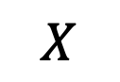
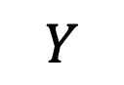

Two Reasons for Estimating $f$
$$E\left[{\left(Y−\hat{Y}\right)}^{2}\right]={\left(E\left[f\left(X\right)−\hat{f}(X)\right]\right)}^{2}+Var\left(\hat{f}(X)\right)+Var\left(ε\right)$$
$$\hat{f}(X)$$
model bias
reducible error
model
variance
variance of
irreducible error
$$Y$$
$$f(X)$$
$$X$$

Slide 37

Two Reasons for Estimating $f$
$$E\left[{\left(Y−\hat{Y}\right)}^{2}\right]={\left(E\left[f\left(X\right)−\hat{f}(X)\right]\right)}^{2}+Var\left(\hat{f}(X)\right)+Var\left(ε\right)$$
model bias
reducible error
model
variance
variance of
irreducible error
$$Y$$
$$\hat{f}(X)$$
$$X$$

Slide 38
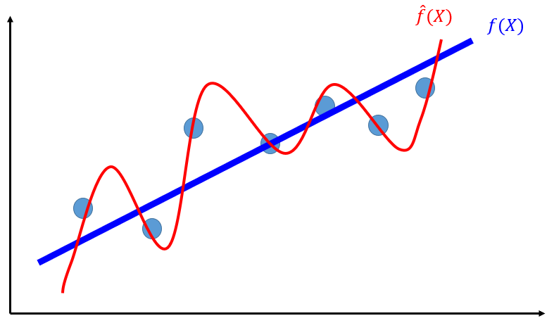
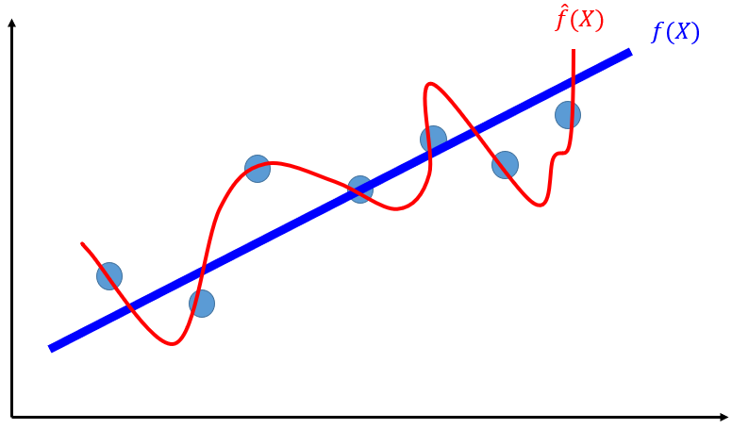
Two Reasons for Estimating $f$
$$E\left[{\left(Y−\hat{Y}\right)}^{2}\right]={\left(E\left[f\left(X\right)−\hat{f}(X)\right]\right)}^{2}+Var\left(\hat{f}(X)\right)+Var\left(ε\right)$$
Why reducing it?
model bias
reducible error
model
variance
variance of
irreducible error
When you have a test sample, the error is high!

Slide 39
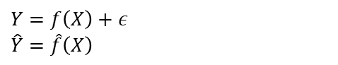
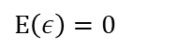
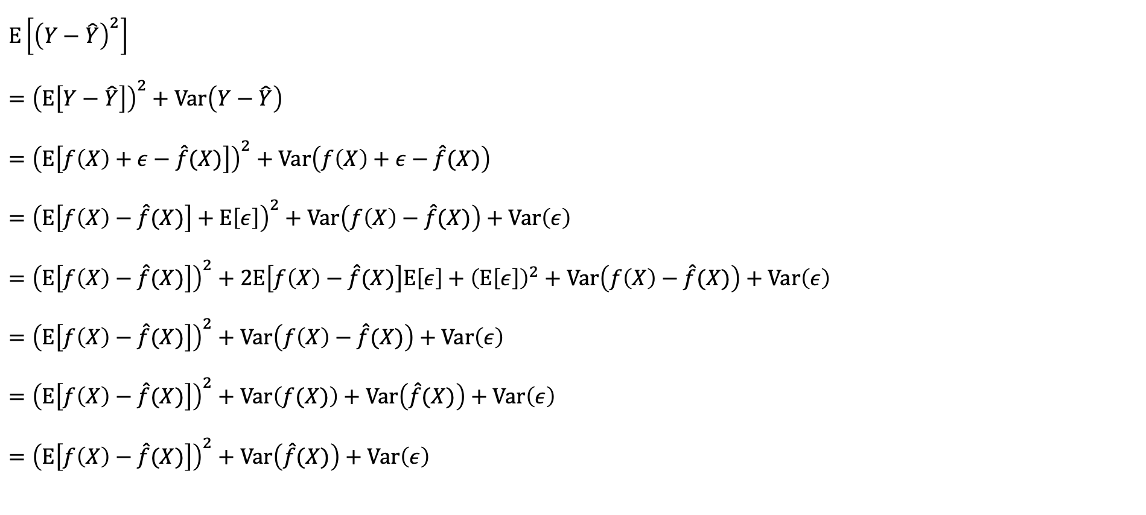



Two Reasons for Estimating $f$
$E\left[{\left(Y−\hat{Y}\right)}^{2}\right]$
$={\left(E\left[Y−\hat{Y}\right]\right)}^{2}+Var\left(Y−\hat{Y}\right)$
$={\left(E\left[f\left(X\right)+ε−\hat{f}(X)\right]\right)}^{2}+Var\left(f\left(X\right)+ε−\hat{f}(X)\right)$
$={\left(E\left[f\left(X\right)−\hat{f}(X)\right]+E\left[ε\right]\right)}^{2}+Var\left(f\left(X\right)−\hat{f}(X)\right)+Var\left(ε\right)$
$={\left(E\left[f\left(X\right)−\hat{f}(X)\right]\right)}^{2}+2E\left[f\left(X\right)−\hat{f}(X)\right]E\left[ε\right]+{\left(E\left[ε\right]\right)}^{2}+Var\left(f\left(X\right)−\hat{f}(X)\right)+Var\left(ε\right)$
$={\left(E\left[f\left(X\right)−\hat{f}(X)\right]\right)}^{2}+Var\left(f\left(X\right)−\hat{f}(X)\right)+Var\left(ε\right)$
$={\left(E\left[f\left(X\right)−\hat{f}(X)\right]\right)}^{2}+Var\left(f(X)\right)+Var\left(\hat{f}(X)\right)+Var\left(ε\right)$
$={\left(E\left[f\left(X\right)−\hat{f}(X)\right]\right)}^{2}+Var\left(\hat{f}(X)\right)+Var\left(ε\right)$
$$Var\left(X\right)=E\left(X^{2}\right)−{\left(E\left(X\right)\right)}^{2}$$
$$→E\left(X^{2}\right)={\left(E\left(X\right)\right)}^{2}+Var\left(X\right)$$
$$Y=f\left(X\right)+ε$$
$$\hat{Y}=\hat{f}\left(X\right)$$
$ε$ is a random error term with mean 0 and independent of $X$
$$E\left(ε\right)=0$$
$f(X)$ is fixed and doesn’t vary.
$f(X)$ is fixed and doesn’t vary. $Var\left(f\left(X\right)\right)=0$
model bias
reducible error
model variance
variance of
irreducible error

Slide 40


Two Reasons for Estimating $f$
Reason 2: Inference
Aim: understand how the response variable is affected by the various predictors (covariates).
The exact form of $\hat{f}$ is the main interest.
What’s the relationship between the response and each predictor?
Can the relationship be linear? Or non-linearity is needed?
Model Interpretability
$$β$$
$$BMI=β_{1}×Weight+β_{2}×HairLength+β_{0}+ε$$

Slide 41

Estimating $f$

Slide 42







Estimating $f$
Overall Idea
Two main approaches
Parametric methods
Non-parametric methods
$$f$$
$$X$$
$$Y$$
$p$ covariates
$$x_{11}$$ | $$x_{12}$$ | $$⋯$$ | $$x_{1p}$$
$$x_{21}$$ | $$x_{22}$$ | $$⋯$$ | $$x_{2p}$$
$$⋮$$ | $$⋮$$ | $$⋮$$ | $$⋮$$
$$x_{n1}$$ | $$x_{n2}$$ | $$⋯$$ | $$x_{np}$$
$$y_{1}$$
$$y_{2}$$
$$⋮$$
$$y_{n}$$
$n$ samples

Slide 43

Estimating $f$
Parametric Methods
They are basically assumption about the shape of $f$.
The multiple linear model is an example of a parametric method: $f\left(x\right)=β_{0}+β_{1}x_{1}+⋯+β_{p}x_{p}+ε$ where $ε\sim N(0,σ^{2})$, $β_{0}$ is an intercept, $β_{i;i∈\left\{1,⋯,p\right\}}$ is a covariate.
The task simplifies to finding estimates of the $p+1$ cofficients $β_{0},β_{1},⋯,β_{p}$. To do this, we use the training data to fit the model, such that $Y≈{\hat{β}}_{0}+{\hat{β}}_{1}x_{1}+⋯+{\hat{β}}_{p}x_{p}$

Slide 44
Estimating $f$
Fitting a parametric model is thus done in two steps:
1. Select a form for the function 𝑓.
2. Estimate the unknown parameters in 𝑓 using the training set.

Slide 45

Estimating $f$
Non-Parametric methods
Non-parametric methods seek an estimate of 𝑓 that gets close to the data points, but without making explicit assumptions about the form of the function 𝑓.
Example: 𝐾-nearest neighbour (KNN) algorithm.
We’ll learn the KNN more in detail in Module 4.

Slide 46

Estimating $f$
KNN
Big dots: training data
Little dots: test data

Slide 47


Estimating $f$
Parametric methods vs Non-Parametric methods
Parametric methods
Non-Parametric methods
NB! We’re talking about conventional statistical learning methods like linear models. It’s not the case for deep learning methods.
Think about KNN.

Slide 48
Prediction Accuracy vs Interpretability

Slide 49
Prediction Accuracy vs Interpretability
Inflexible methods:
Linear regression (M3)
Linear Discriminant Analysis (M4)
Subset Selection and Lasso (M6)
Flexible methods:
KNN classification (M4), KNN regression, Smoothing splines (M7).
Bagging and Boosting (M8), Support Vector Machines (M9)
Neural Networks (M11)

Slide 50


Prediction Accuracy vs Interpretability
Why would I ever prefer an inflexible methods?
$$\hat{f}(X)$$
$$\hat{f}(X)$$
Test data
Test data
Inflexible
Flexible

Slide 51

Prediction Accuracy vs Interpretability
Potential Problems with High Flexibility

Slide 52

Prediction Accuracy vs Interpretability
Potential Problems with High Flexibility

Slide 53
Example for Potential Problems with High Flexibility

Slide 54


Example for Potential Problems with High Flexibility
$$Y=x^{2}+ε$$
$$ε\sim N({0,2}^{2})$$

Slide 55


Example for Potential Problems with High Flexibility
Fitting a Polynomial Function
Poly1: $\hat{y}=β_{0}+β_{1}x$
Poly2: $\hat{y}=β_{0}+β_{1}x+β_{2}x^{2}$
Poly10: $\hat{y}=β_{0}+β_{1}x+β_{2}x^{2}+⋯+β_{10}x^{10}$
Poly20: $\hat{y}=β_{0}+β_{1}x+β_{2}x^{2}+⋯+β_{20}x^{20}$
Flexibility
increases
We know that the best fit is Poly2.
$$Y=x^{2}+ε$$
$$ε\sim N({0,2}^{2})$$

Slide 56


Example for Potential Problems with High Flexibility
Problems with High Flexibility
$E\left[{\left(Y−\hat{Y}\right)}^{2}\right]$ decreases with the higher polynomial order.
But we know that poly2 is the best fit.
How do we assess the best fit?

Slide 57
Assessing the Model Accuracy

Slide 58





Assessing the Model Accuracy
Measuring the Quality of Fit
You study for an exam, and often with the previous years’ exams.
You take the exam.
$X_{test}$ (test dataset)
$X_{train}$ (training dataset)

Slide 59








Assessing the Model Accuracy
Measuring the Quality of Fit
During Training
$$f_{θ}$$
$$MSE_{train}=\frac{1}{n}\sum_{i=1}^{n}{{\left(y_{i}−\hat{y}\right)}^{2}}$$
$$X_{train}$$
$$Y_{train}$$
During Testing
$$MSE_{test}=\frac{1}{n}\sum_{i=1}^{n}{{\left(y_{i}−\hat{y}\right)}^{2}}$$
$$f_{θ}$$
$$X_{test}$$
$$Y_{test}$$

Slide 60


Assessing the Model Accuracy
Measuring the Quality of Fit
$$MSE_{train}=\frac{1}{n}\sum_{i=1}^{n}{{\left(y_{i}−\hat{y}\right)}^{2}}$$
Your score on your mock exam
(training dataset)
$$MSE_{test}=\frac{1}{n}\sum_{i=1}^{n}{{\left(y_{i}−\hat{y}\right)}^{2}}$$
Your score on the actual exam
(test dataset)

Slide 61

Example for Potential Problems with High Flexibility
Then, we can create $X_{train}$ and $X_{test}$ from $X$
We have $X$.
We randomly pick 80% of $X$ as $X_{train}$ and the rest is $X_{test}$.
We train $\hat{f}$ on $X_{train}$ and test on $X_{test}$

Slide 62


Assessing the Model Accuracy
MSE (Mean Squared Error) Illustration
$$MSE_{ }=\frac{1}{n}\sum_{i=1}^{n}{{\left(y_{i}−\hat{y}\right)}^{2}}$$

Slide 63





Assessing the Model Accuracy
Example of $MSE_{train}$ and $MSE_{test}$
$$MS{E_{test}}_{ }$$
$$MS{E_{train}}_{ }$$
e.g. polynomial order

Slide 64
Assessing the Model Accuracy
Quiz: How would you select the best model?
$$MS{E_{test}}_{ }$$
$$MS{E_{train}}_{ }$$
1
2
3
e.g. polynomial order

Slide 65
Bias-Variance Trade-off

Slide 66

Bias-Variance Trade-off
Bias and Variance?
NB! The U-shape of $MS{E_{test}}_{ }$
$$MS{E_{test}}_{ }$$
$$MS{E_{train}}_{ }$$
e.g. polynomial order

Slide 67

Bias-Variance Trade-off
NB! The U-shape of $MS{E_{test}}_{ }$
$$MS{E_{test}}_{ }$$
$$MS{E_{train}}_{ }$$
e.g. polynomial order

Slide 68



Bias-Variance Trade-off
How to Choose the Best Model
NB! The U-shape of $MS{E_{test}}_{ }$
$$MS{E_{test}}_{ }$$
Obviously
here
$$MS{E_{train}}_{ }$$
e.g. polynomial order

Slide 69





Bias-Variance Trade-off
Decomposition of MSE
$$MS{E_{test}}_{ }$$
$$MS{E_{train}}_{ }$$
e.g. polynomial order

Slide 70

The End!

